Slide 1
Notes:
Tenants and staff from a retirement scheme in north London run by Network Homes, arriving at EAC Housing Awards 2019 to celebrate their win.

Slide 2
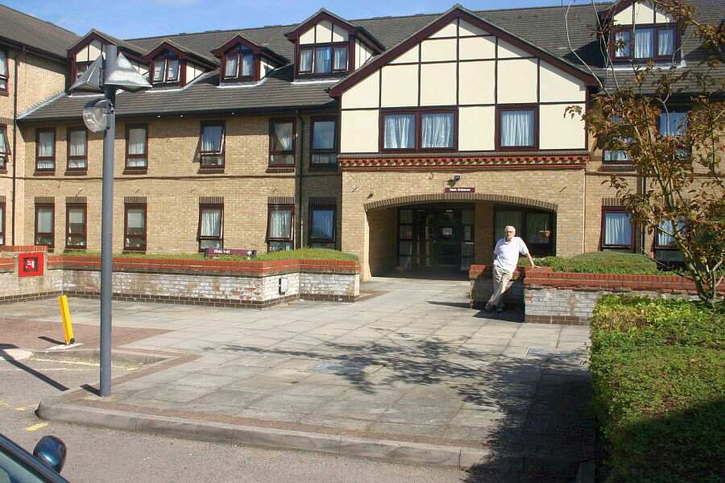
Notes:
This is where they live - Kingsley Court, a large but traditional sheltered development of 73 one and two bedroom units, built in 1991.

Slide 3
Notes:
Home owners from Boat Lane Court, a leasehold development in Manchester

Slide 4
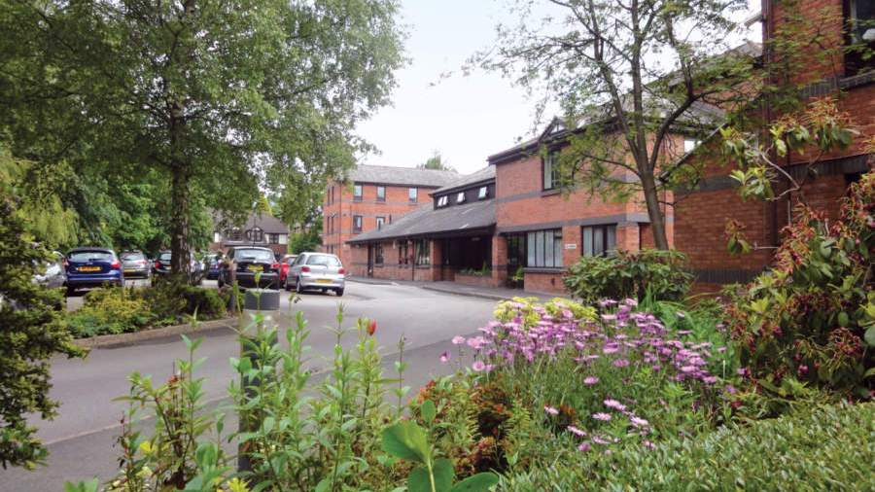
Notes:
Boat Lane Court by Retirement Security Ltd built in in partnership with Bovis Homes in 1991. A pioneering and very successful example of private extra care housing – though at the time marketed as ‘very sheltered housing’.

Slide 5
Notes:
And finally a group of residents who live in Maxton House, Farnworth, near Bolton.

Slide 6
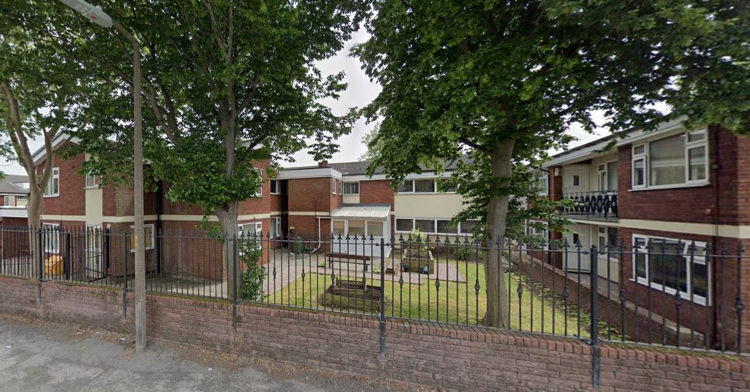
Notes:
This is Maxton House, and it has quite a backstory. Built back in 1975 as a sheltered housing scheme by Bolton Council, it transferred via an ALMO to independent housing association Bolton Homes, who subsequently upgraded and remodelled it into an extra care scheme.

Slide 7
Understanding the market in 2023
Older people’s housing taskforce 2023
John Galvin, Chief Executive, EAC
john.galvin@eac.org.uk

Slide 8
About EAC
Older people’s housing taskforce 2023
Charity mission since 1985:
“To help older people reach informed decisions about meeting their housing and care needs.”
Main Activities:
Creation & maintenance of National Database of Housing for Older People
Website HousingCare.org
Telephone information & advice service until 2020
Led creation of FirstStop Advice network across England, 2008 - 2016
Created and ran National Housing for Older People Awards, 2010 - 2019
Notes:
At EAC we’ve had the privilege and pleasure to spend just over 30 years assembling a picture of the UK’s supply of specialist housing for older people, which we believed we needed if we wanted to inform and guide older people and their families about the housing options open to them.
It’s been a labour of love – very had going, and initially meeting a lot of resistance. But it has led us as individuals, and as an organisation, to appreciate what these forms of communal living can and do offer older people. Not the solution everyone looks for, but can be a life changer for those who choose it.
On the way we’ve come to understand a lot about the driving forces behind the growth of sheltered housing, seen it in action at its best and worst, and seen it buffeted regularly as political and financial support for it waned. Let me try to outline its history in a few words and one graph.

Slide 9
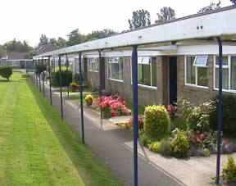
Specialist housing for later life - a rich history
Parsons Green,
Shrewton,
Wiltshire
Salisbury District Council
1966
9
Notes:
As we understand it, sheltered housing sprung directly from the leading role that local councils came to play in rebuilding after WW2. Prior to the war private renting was the dominant tenure, for all ages. But after a huge post war rebuilding effort LAs were coming to dominate housing provision. Provision for families was their priority, and so they constructed millions of 3 bedroom homes – flats in the cities and houses elsewhere.
But they, and central government as paymaster, realised there had to be a mechanism to recycle these large homes once children flew the nest. ‘Sheltered housing’ comprising small low rise flat blocks or clusters of bungalows were therefore part of a grand plan to make efficient use of precious housing assets.

Slide 10
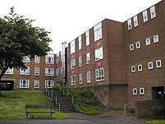
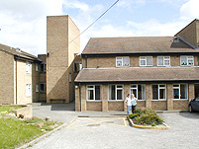
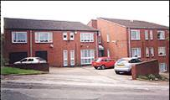
Specialist housing for later life - a rich history
Sheffield City Council
1971 - 1980
10
Notes:
The expectation, the ‘deal’ if you like, was that affordable new publicly provided homes were for a certain life stage, after which tenants would be expected to take up the offer of a smaller and more suitable home, usually close to their former family home, friends and neighbours.
We were staggered when we were able to count numbers of sheltered properties in some areas and look at these against census data for those early days. The deal must have been implemented very effectively!
From the mid 1960s housing associations took on more responsibility for building and/or managing sheltered housing, and construction continued at a high level through to around 1990.
Let’s look at a graph of this, which enables me to add in a couple more important ingredients . ..

Slide 11
Older people’s housing taskforce 2023
Notes:
This graph shows new construction of sheltered housing from 1951 through to 2000. The public and social sector provision I’ve talked about so far is shown in red, peaking at around 18k properties a year.
But the new ingredient, shown in blue, is the entry into the marketplace of private developers building properties for sale. A gradual increase in home ownership in the general housing market, boosted considerably from 1980 by the ‘right to buy’ for council tenants, persuaded them that a version of sheltered housing for downsizing owner occupiers might be a winner. For a short decade there was a flurry of building ‘retirement housing’ for sale, as shown in blue on the chart.
Unfortunately this ended in tears for a number of reasons, including the fact that most companies active at the time were simply house builders - with little understanding of, or interest in, the longer term responsibilities that accompany providing housing for older people.
Meanwhile, as we can see, development by social sector providers started fall rapidly – I think for multiple reasons, some of which I’ve bulleted on the next slide.

Slide 12
Older people’s housing taskforce 2023
The end of one era
Underfunded social sector provision
Impact of ‘right to buy’ on flow of customers into social sector provision
Flawed private sector model
Competition from expanding care home sector
A model not designed to address frailty and ill health
But despite all, a service and way of living that worked for so many older people
Notes:
In summary, a golden era of building sheltered housing came gradually to an end in the mid 1990s after 30 years. The Taskforce might want to explore the reasons in more detail.
Happily however, the story doesn’t end there!

Slide 13
Older people’s housing taskforce 2023
Development of new models, emergence of extra care
During the later years of the 20th century a number of local authorities and housing associations began to build, or upgrade existing schemes into ‘enhanced’ or ‘extra care’ sheltered housing.
Key initiatives included:
DH (DHSC) sponsored Integrated Care Network and offshoot Extra Care Housing Learning & Improvement Network (Housing LIN), established 2003
Launch of the DH Extra Care Housing Fund from 2005-06
National Strategy for Housing in an Ageing Society: Lifetime Homes, Lifetime Neighbourhoods, DCLG, DH, DWP, published 2008
HAPPI (Housing our Ageing Population: Panel for Innovation), established 2009
Notes:
So much work has been done during the last 25 years to develop, test and pilot new models of housing for later life. This has brought government departments together (DLUCH, DHSC and at times DWP ) to work towards a new vision.
The research community have been busy throughout evaluating innovative developments, and helping to solve some of the challenges we face as we try to create living options that accommodate older people as full and valued members of our society, help them stay healthy and engaged, and at the same time be ready with appropriate support, and ultimately care, if/when needed.
So much lasting commitment has been made by local authorities, and key officers within them, often driven by a determination to roll back the use of residential care to where it is the necessary or best option for individuals.
Last but far from least, we have seen leaders emerge in the private sector who are now contributing substantially towards developing a mixed economy of provision available to all sections of society.

Slide 14
Older people’s housing taskforce 2023
Notes:
This graph extends the one I showed earlier up to the present day. Although the annual totals of new provision remain low compared with the past, they have increased slowly since the turn of the century, and would have looked more steady in the last 3 years had Covid not happened. Notably, the private sector (broadly what is shown in blue) has contributed over 50% of new supply during the last two decades.
However annual new supply is not a complete measure of progress. Given the age of much existing stock, two other factors are important for a full picture:
1. The extent to which we are now investing in repairing, refurbishing and where necessary re-configuring older developments. This is certainly happening, but EAC’s tracking of it is far from complete. We hope to explore it further during the lifetime of the Taskforce.
2. The rate at which older schemes are being lost – through disposal or change of use, or to make way for development of a new retirement housing complex. We have been able to partially quantify this. An average of at least 97 schemes / approximately 1,900 units a year have been ‘lost’ over the last 25 years, almost all of which are older social sector schemes – the red part of the bars on our graph. Stripping 1,900 units out of the social sector’s recent new-build figures reduces that sector’s net contribution to increasing supply to almost nil – but arguably is exactly what the sector should be doing, given the large volume and age of its stock.

Slide 15
Older people’s housing taskforce 2023
Notes:
I’ll end with a quick introduction to 5 slides that home in on different aspects of the retirement housing market we have now.
This one shows that Housing-with-Care / Extra Care provision now makes up a sizeable proportion of new supply in all regions – but that traditional sheltered/retirement developments are still being built in almost equal numbers. This is also a small percentage of new provision that we call simply ‘age-restricted’, which is low on facilities and services, but can meet the downsizing or re-location ambitions, and pockets, of some older people.
The slide also highlights substantial variations between English regions in the mix of scheme types built in the last 5 years.

Slide 16
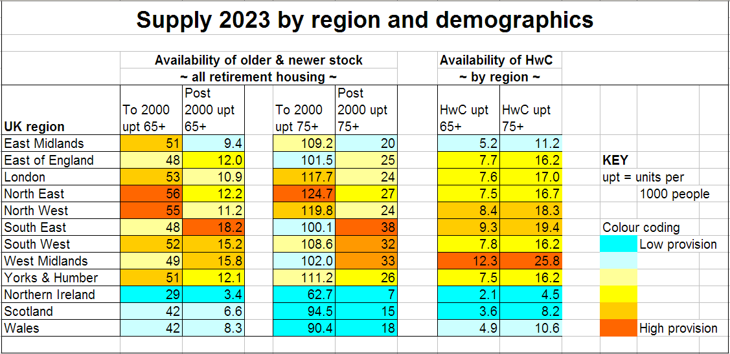
Older people’s housing taskforce 2023
Notes:
This one relates new build figures to older populations within each region, using the latest Census data to produce ‘upt’ measures (units per 1000 older people).
It highlights an uneven distribution of both historic supply and recent new-build between regions, and includes a specific look at the total supply of HwC (housing-with-care) in each region.

Slide 17
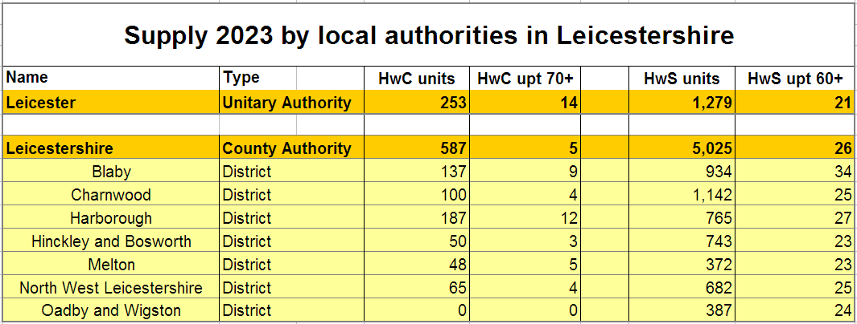
Older people’s housing taskforce 2023
Notes:
This slide digs deeper into supply in the historic county area of Leicestershire, which administratively now comprises one unitary authority (Leicester) plus a hierarchical County/District structure in which Leicestershire County Council is responsible for social care and the District Councils for housing and planning.
Note the much wider variation in HwC provision across the area compared to a fairly even provision of older HwS (housing-with-support /sheltered housing).

Slide 18
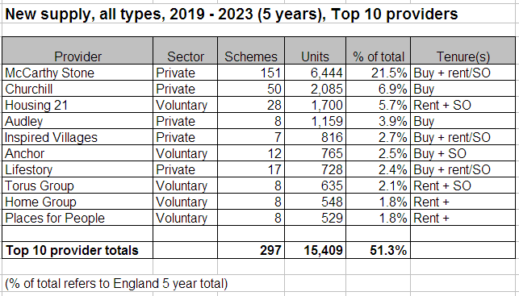
Older people’s housing taskforce 2023
Notes:
This one provides a snapshot of who the main providers of housing for older people are at present.

Slide 19
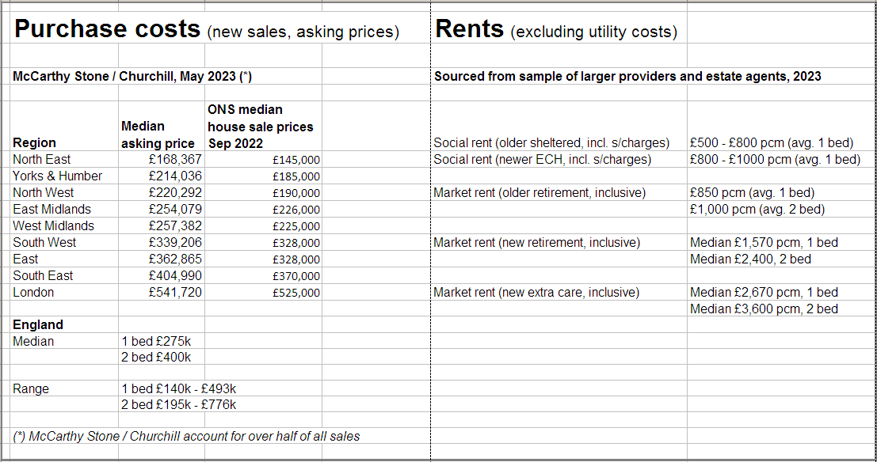
Older people’s housing taskforce 2023
Notes:
This slide provides a teaser of what we know, and could track more consistently and in more detail, on costs and affordability.
As might be expected, there are large differences in costs depending on location, scheme type, property size and age, and tenure – even excluding some costs that EAC no longer tracks systematically (for example Ground rents, Deferred charges (‘exit fees’), Utility costs (if included).
Inevitably, as the retirement housing market has grown and diversified, charging structures have become more varied – making the consumer’s job more difficult.
To the old conundrum – “Should I stay or should I move?” has been added “And if I move, what can I afford, and how should I pay for it?” Plus, particularly in relation to extra-care housing, “How does this dovetail with my entitlement to help towards care costs?”

Slide 20
Older people’s housing taskforce 2023
End thoughts . .
We should take pride in the quantity, diversity and quality of the retirement housing we have in the UK. Despite the age of much of the stock, those who choose it continue to rate it.
We need to pay urgent attention to both increasing new supply and looking after (or replacing) older stock.
Older people considering a move today enter a largely second hand market, and will judge the product by what they see available and affordable locally:
c.74% of those who buy will buy an older property
c.95% of those who rent will rent an older property
Because of the prevalence of older stock, we may have an image problem. Can we establish whether this is the case - and if so what can we do about it?
Notes:
Finally a few personal thoughts, of which the one I’d particularly emphasise is the 3rd.
However fast new building can and should be made to happen, our existing sheltered and retirement stock will dominate the market for years to come. What are we going to recommend is done about this?

